Slide 1
SEIS IOT Based Smart Home Fire-Smoke Detection System
Emre IŞIK
Emre SÖZEN
Samet Enes BAYEZİT
Hüseyin PAMUK
Arda BERBER
Caner ÖZCAN

Slide 2
Contents
Project Introduction
Sensors Used in the Project
How Did We Produce The Project and What We Used?
Operating the Device

Slide 3

PROJECT INTRODUCTION

Slide 4

What does this Project do? The goal of the project
Fire Detectors
Smart Homes (IOT)
SEIS

Slide 5
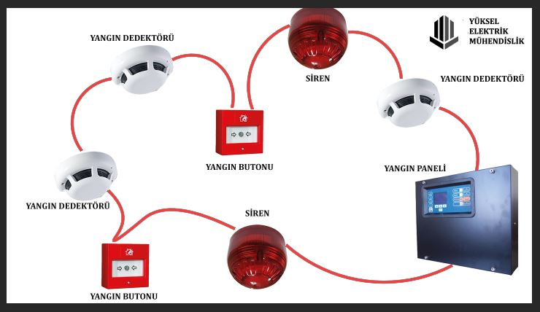
CLASSIC FIRE ALARM SYSTEM

Slide 6
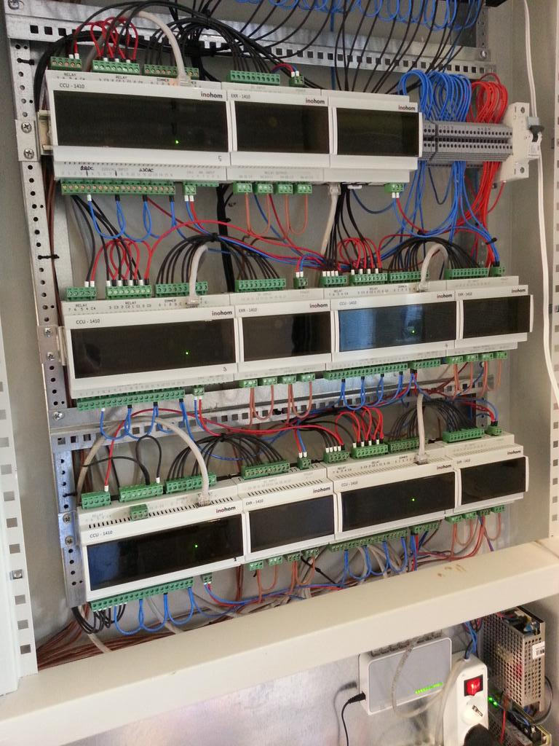
Smart Home Electrical Panel

Slide 7
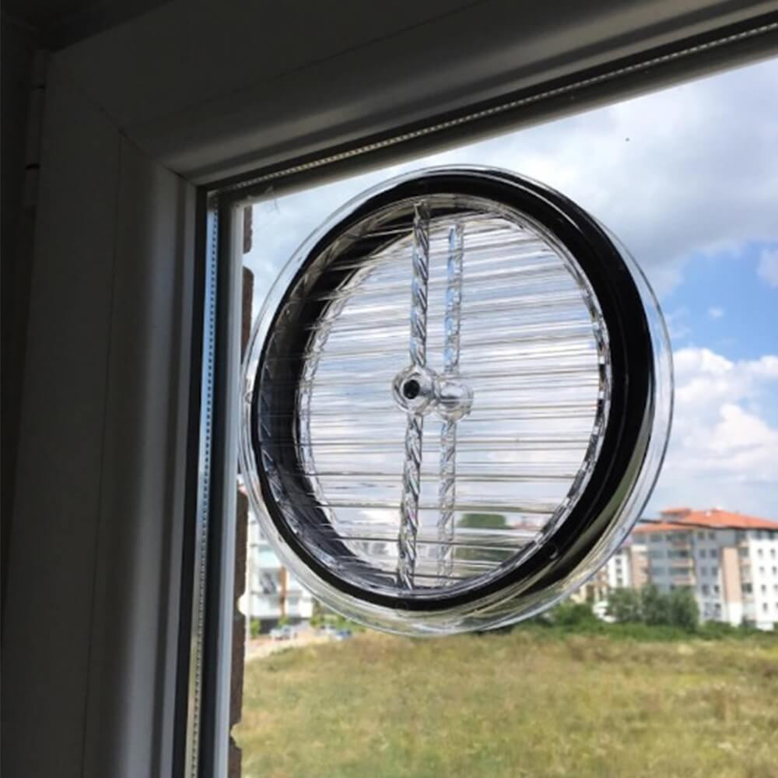
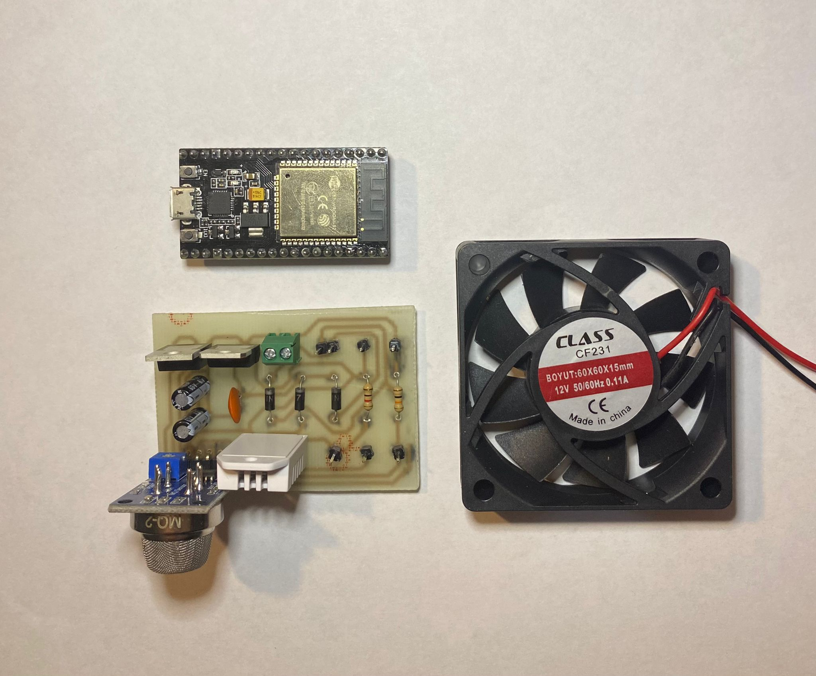
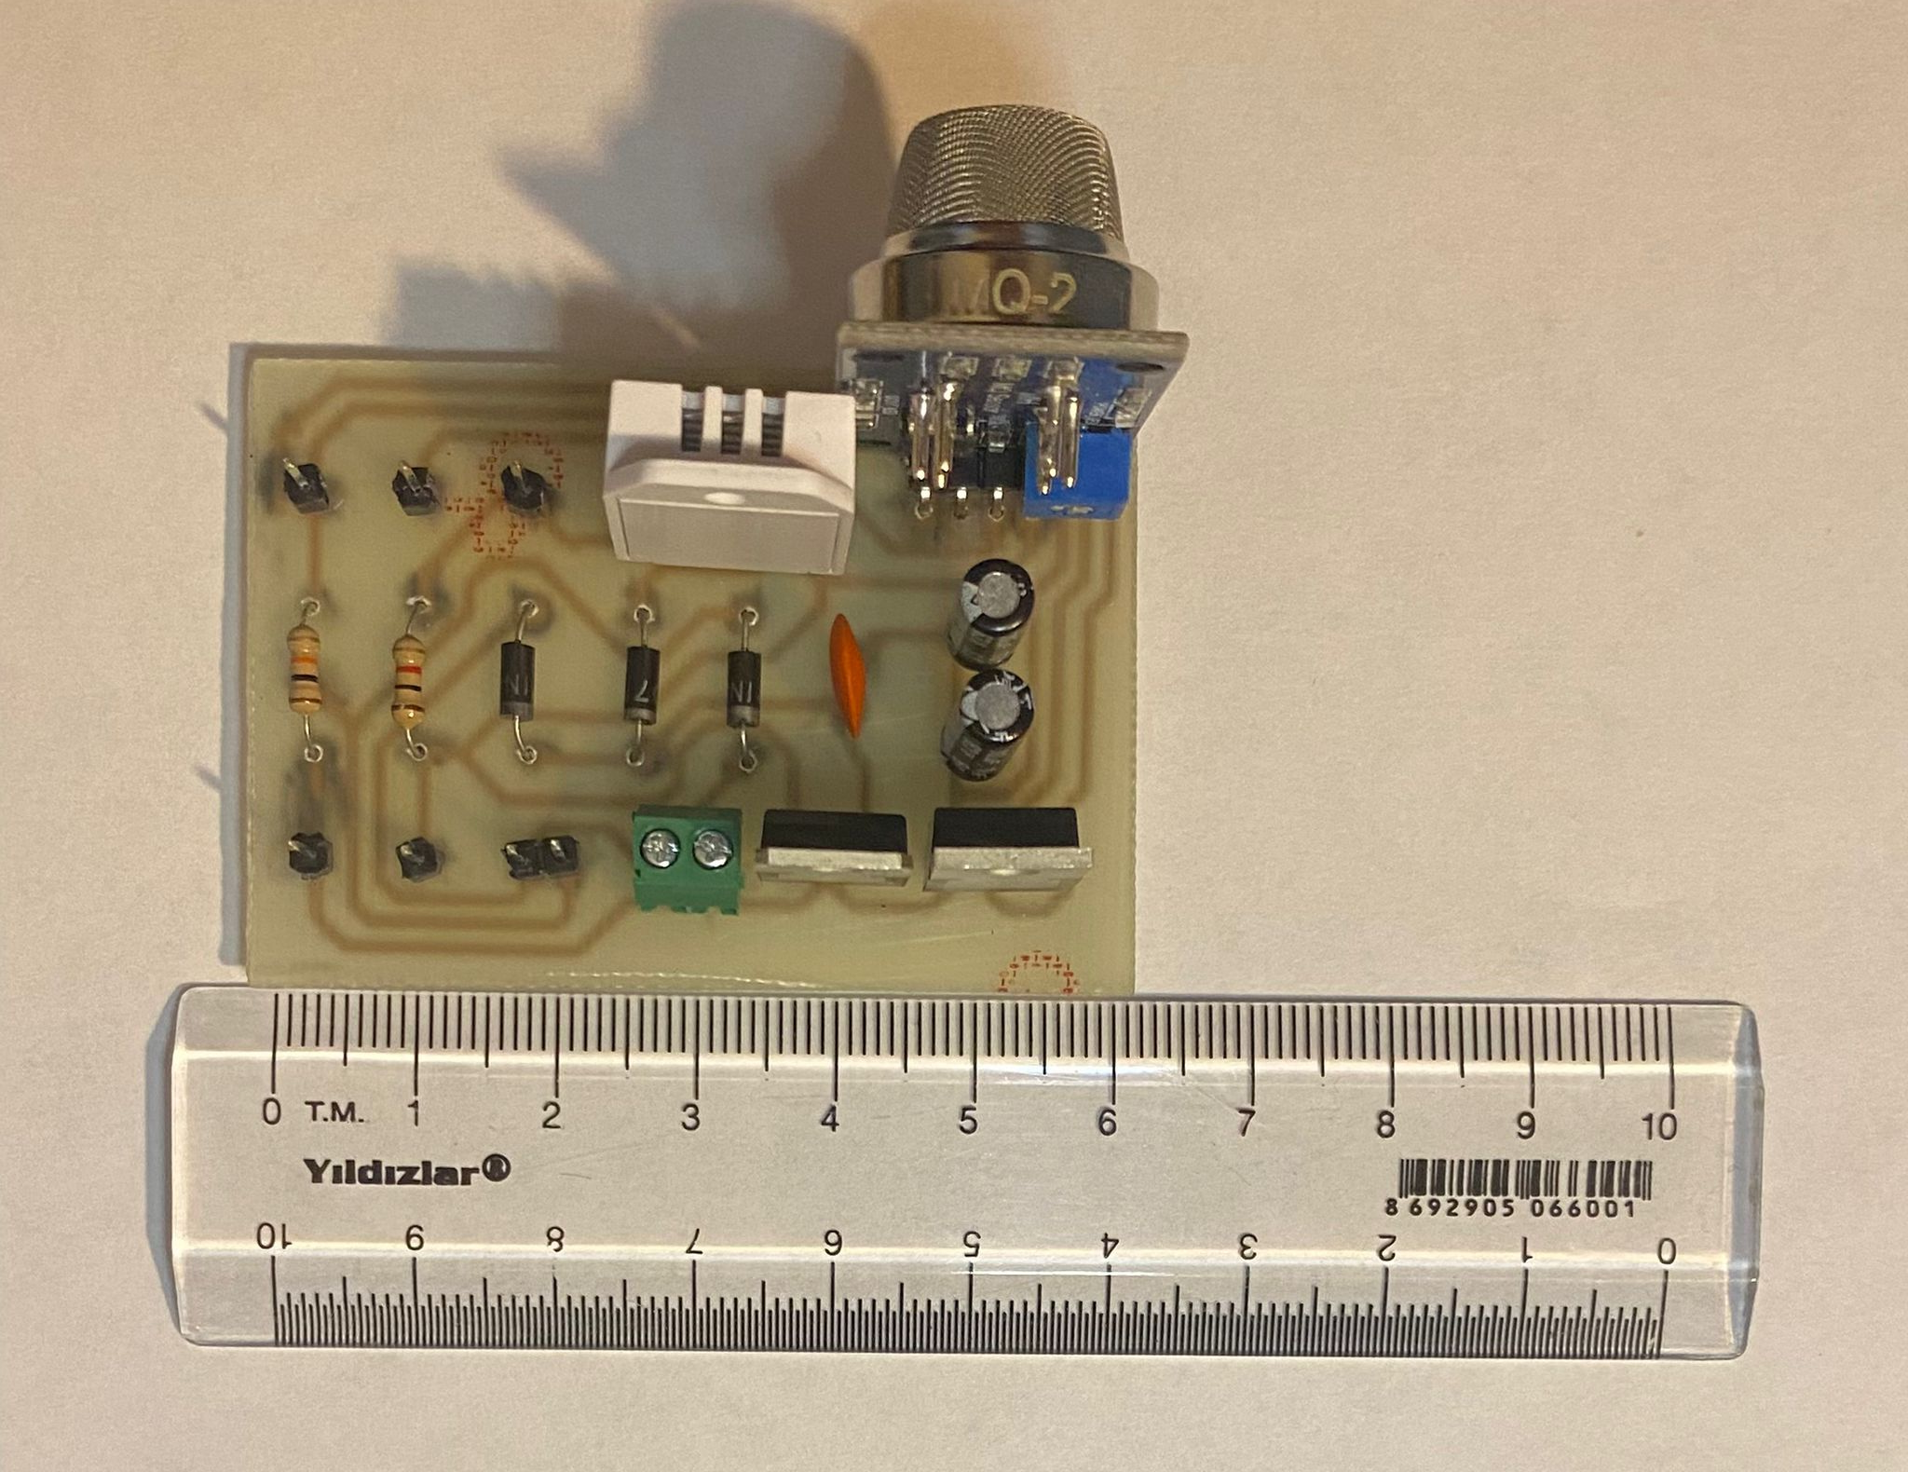
SEIS IOT Based Smart Home Fire-Smoke Detection System
1
2
3

Slide 8
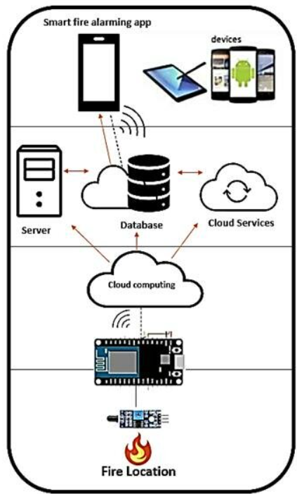



How SEIS Works?
Web Site/ Panel
Service
Detection-Calculation-WiFi
Microcontroller
Fire-Smoke
Detection

Slide 9
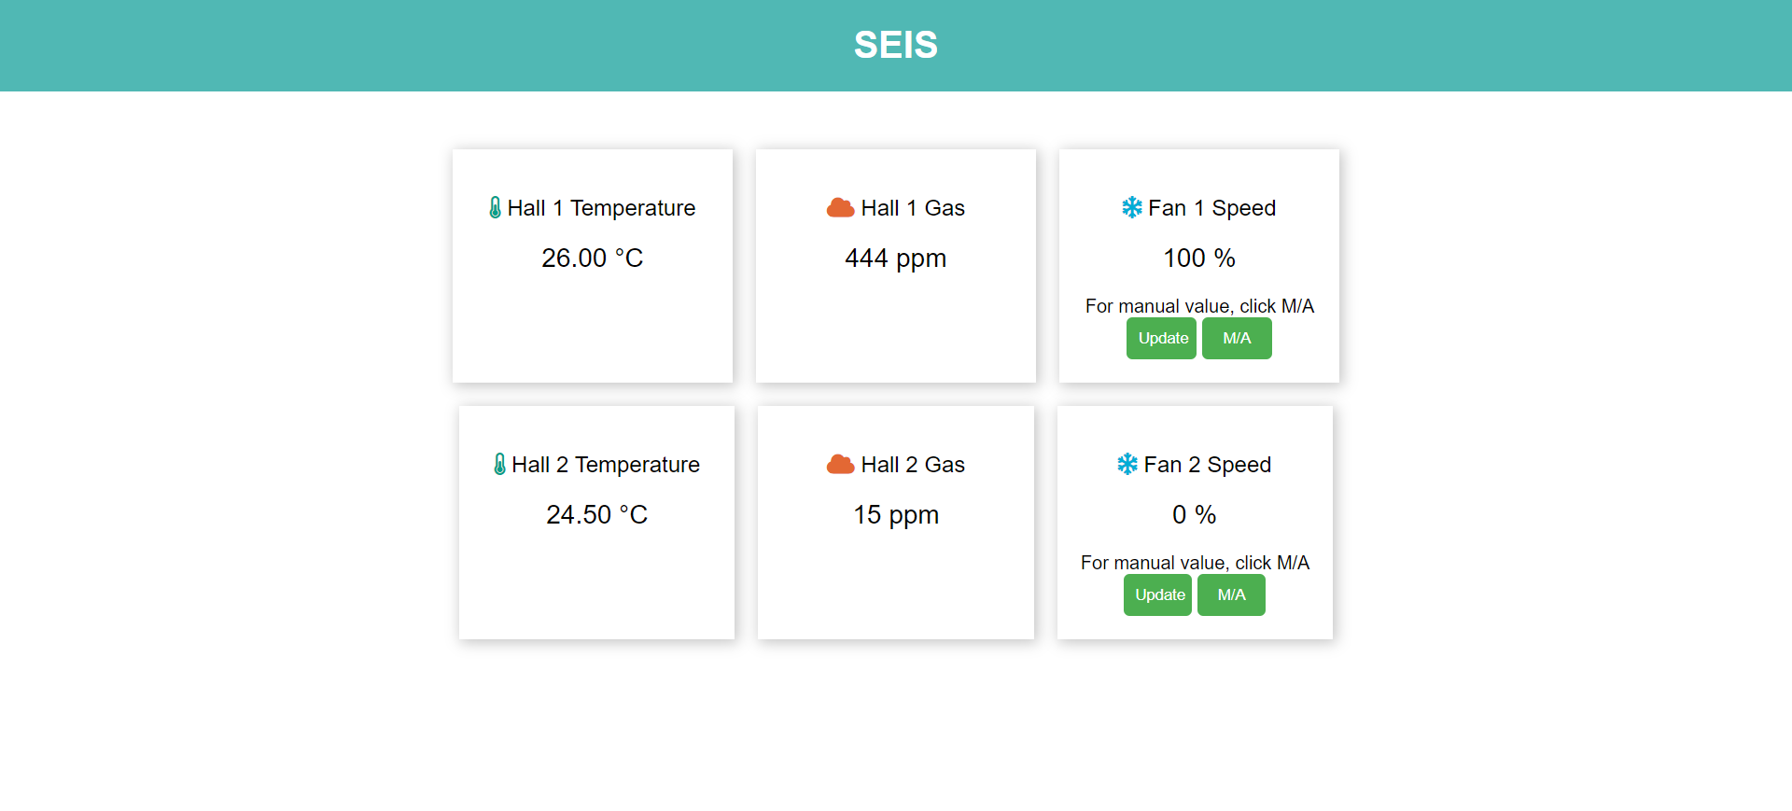
Web Control Panel

Slide 10
For Summary
Features | Classic Fire Alarm Systems | Smart Home Fire Alarm Systems | SEIS
Fire and Smoke Detection | ü | ü | ü
Easy Integration | û | û | ü
Air Evacuation | û | ü | ü
Air Conditioning | û | û | ü
Internet Connection and Panel | û | ü | ü
User Notification-Alarm(IOT) | û | ü | ü
Cost | VERY HIGH | VERY HIGH | VERY LOW

Slide 11

SENSORS USED IN THE PROJECT

Slide 12
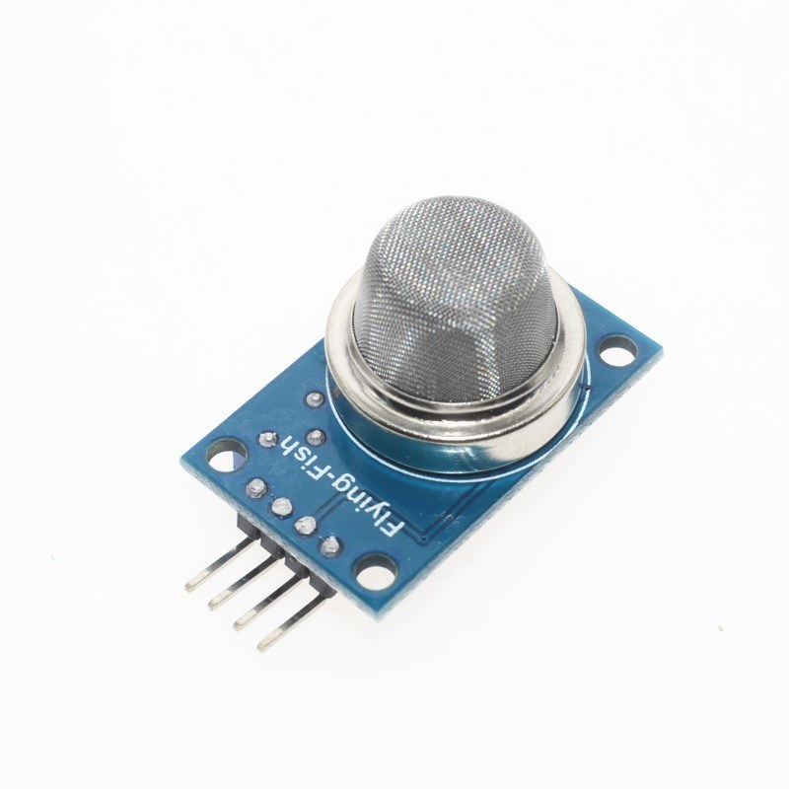
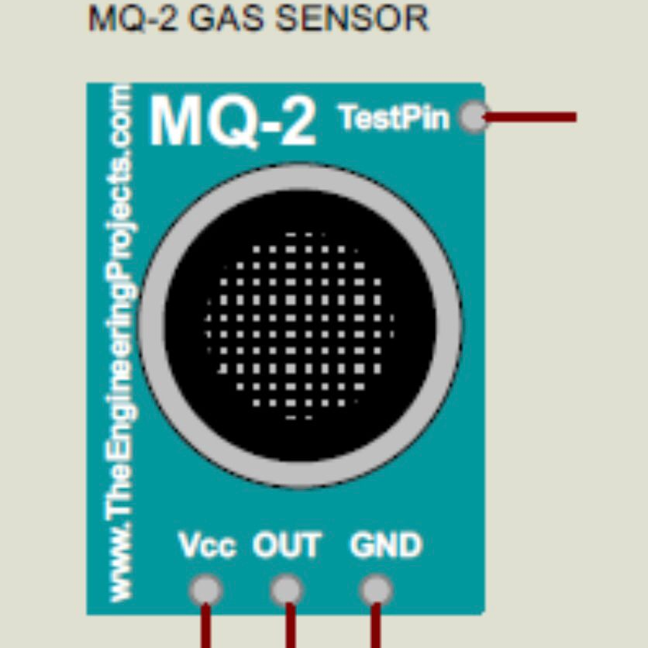
MQ-2 GAS SENSOR
MQ2 Gas sensor is a Metal Oxide
Semiconductor (MOS) type Gas
Sensor mainly used to detect gases
like Methane, Butane, LPG, Smoke, etc.

Slide 13
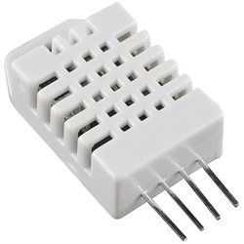
DHT22
DHT22 Digital Temperature and Humidity Sensor; It is a basic, low-cost, digital temperature and humidity sensor.
A capacitive humidity sensor and a thermistor are used to measure the surrounding air. It sends a digital signal to the data pin. This completes the reading process.

Slide 14

HOW DID WE PRODUCE THE PROJECT?

Slide 15
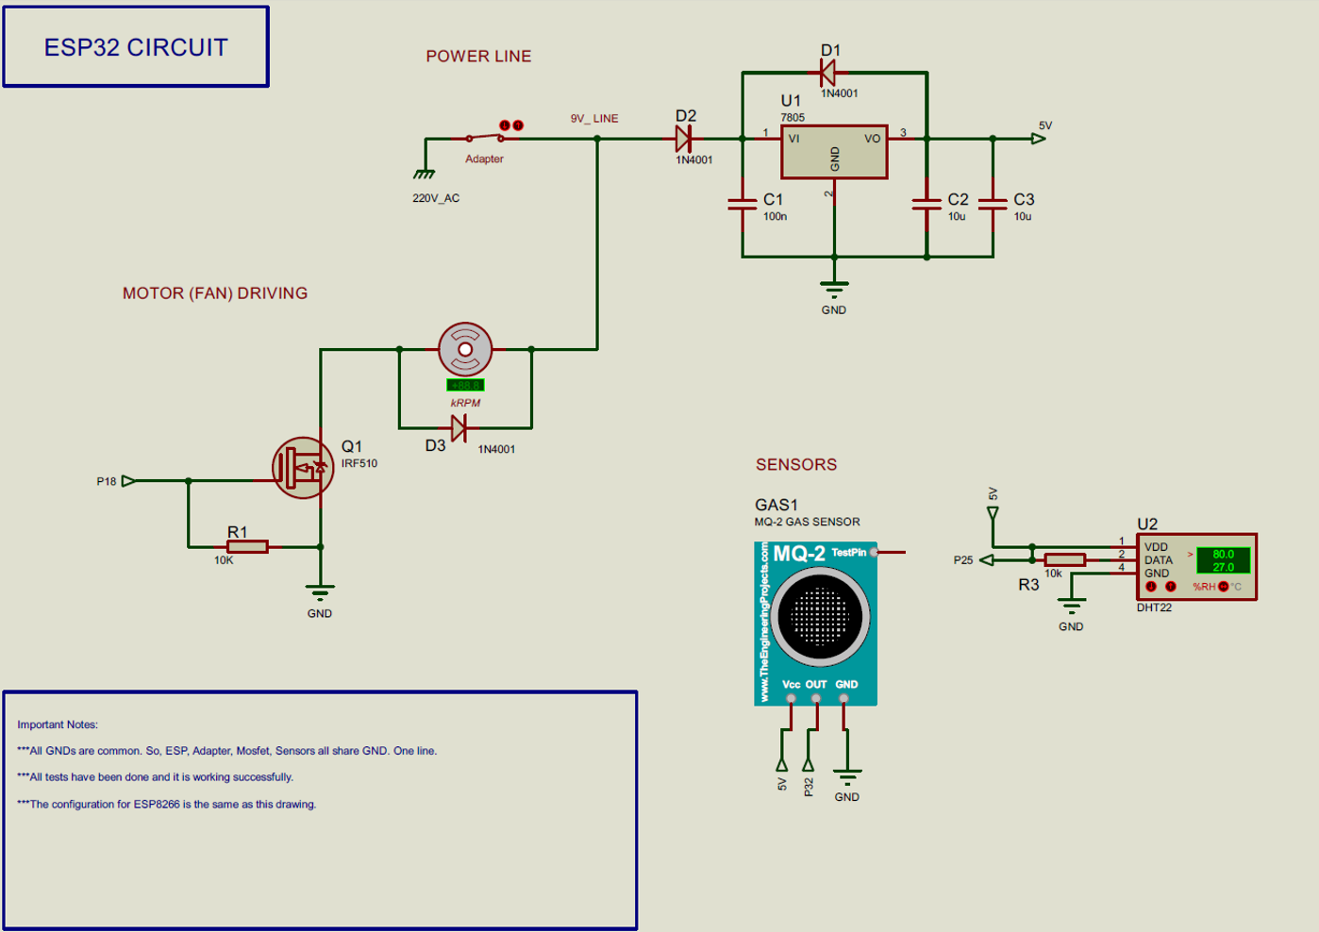

DESIGNING A PCB BOARD
We used PROTEUS program to design and simulate our circuit schematic.

Slide 16
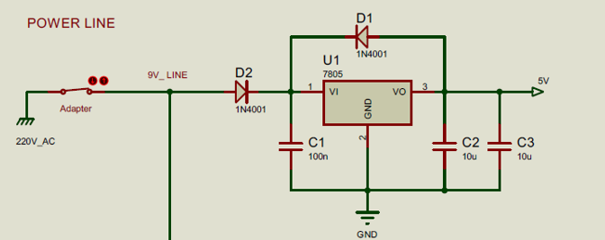
VOLTAGE REGULATOR
220v energy is taken from the socket with the adapter, but 220 v energy cannot be used in the circuit. First, this energy is reduced to 9v with the adapter. 9v energy is still too much for the heat sensor and gas sensor. Due to this situation, a voltage regulator is used to reduce the voltage. The 5v energy coming out of the voltage regulator is transmitted to the gas sensor and heat sensor. At the same time, the energy transmitted to the sensor is also transmitted to the ESP.
(A voltage regulator produces a constant output voltage of a preset magnitude, which remains constant regardless of changes in the input voltage or load conditions.)

Slide 17
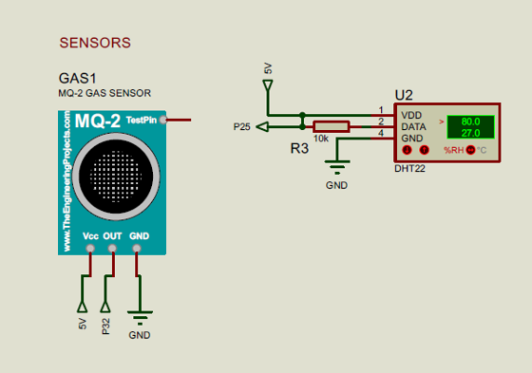
SENSORS
The 5v energy coming from the voltage regulator passes through the VCC input of the gas sensor and the VDD input of the heat sensor. The gas sensor is transferred to the analog input of the ESP, and the heat sensor is transferred to the digital input of the ESP.

Slide 18
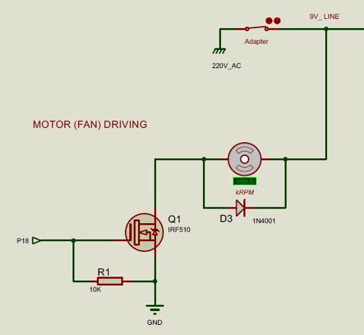
MOTOR
Mosfet is used to drive the motor. Mosfet is used with PWM output from ESP. The speed of the motor is adjusted according to the PWM value coming from the ESP.

Slide 19
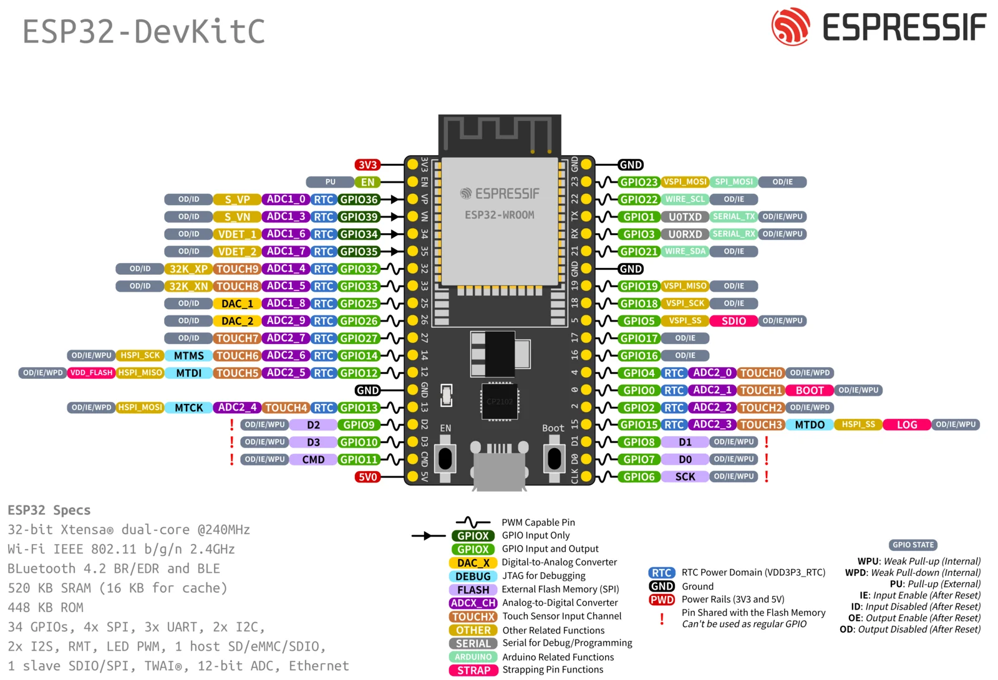

Slide 20
HOW WE PRODUCED THE PCB BOARD
Designing a PCB board.
1
Applying the designed PCB board to reality.
2
Placing circuit elements on the PCB board.
3

Slide 21
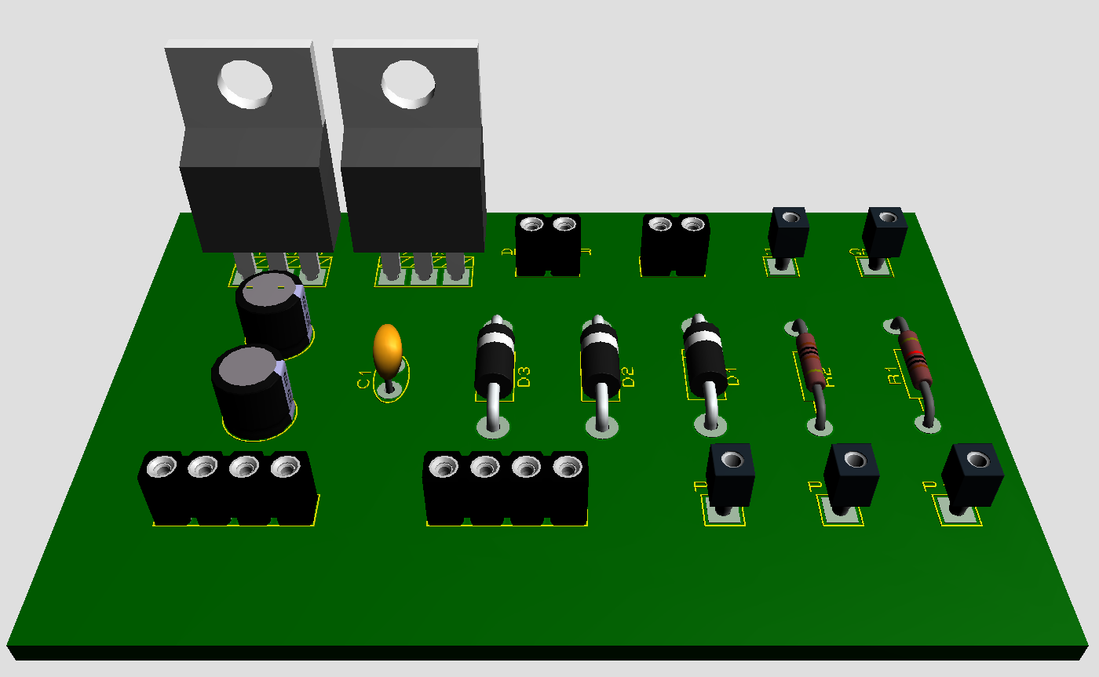
DESIGNING A PCB BOARD
First, we placed the circuit elements on the board and look at the 3D image. If we don’t look at this 3D image, circuit elements may overlap due to their covers.

Slide 22
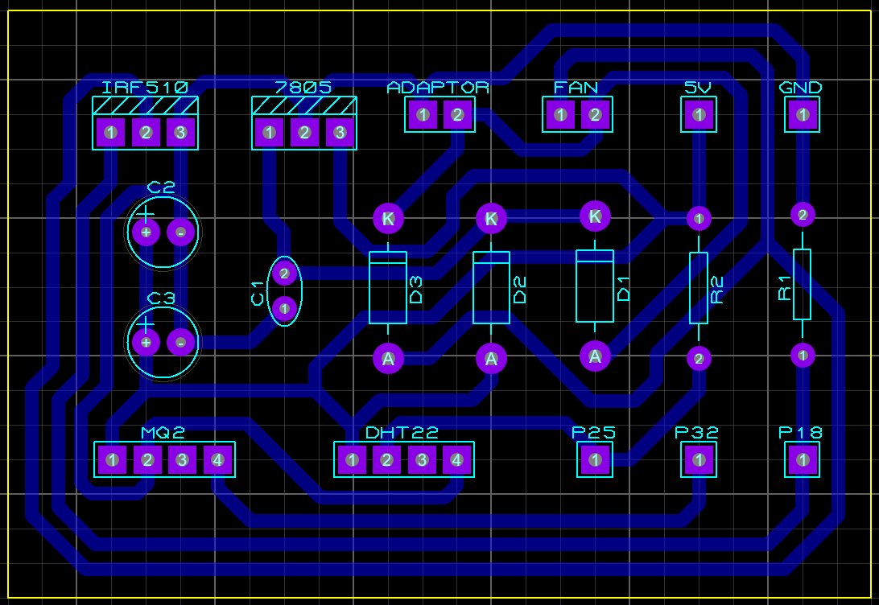
DESIGNING A PCB BOARD
After placing the circuit elements,
I drew the connections.
Blue lines represents the connections.
The yellow rectangle represents the board.

Slide 23

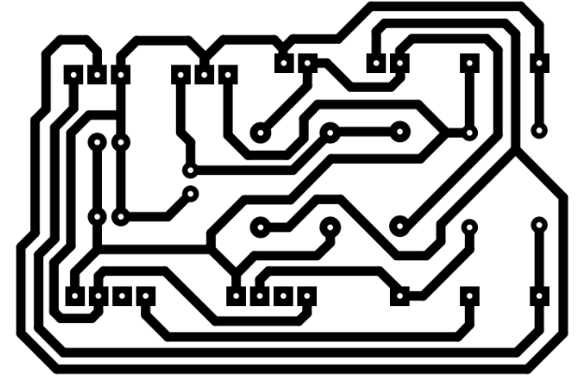
APPLYING THE DESIGNED PCB BOARD TO REALITY
After designing the circuit, we print only the connection diagram of the circuit on glossy paper.
GLOSSY PAPER
CONNECTION DIAGRAM

Slide 24

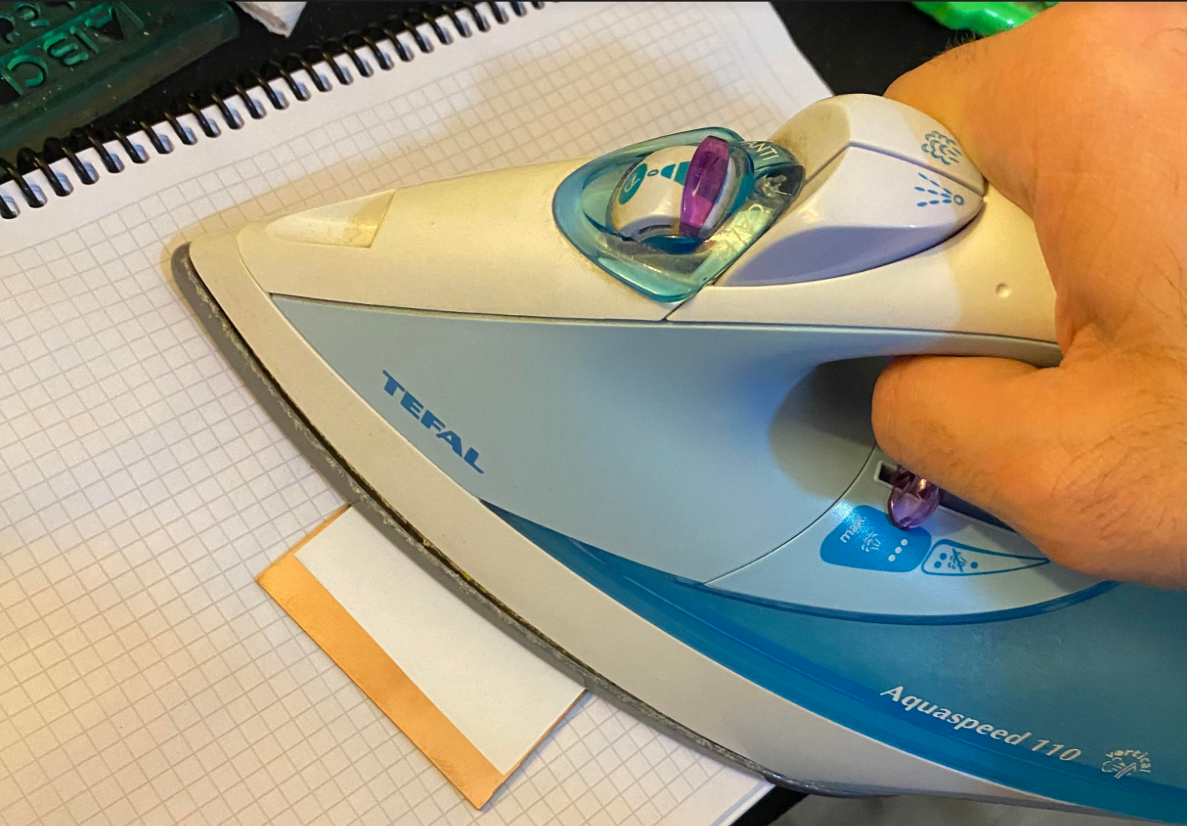
APPLYING THE DESIGNED PCB BOARD TO REALITY
I transferred the printed schematic to a copper plate with the help of heat.
COPPER PLATE
APPLYING HEAT

Slide 25


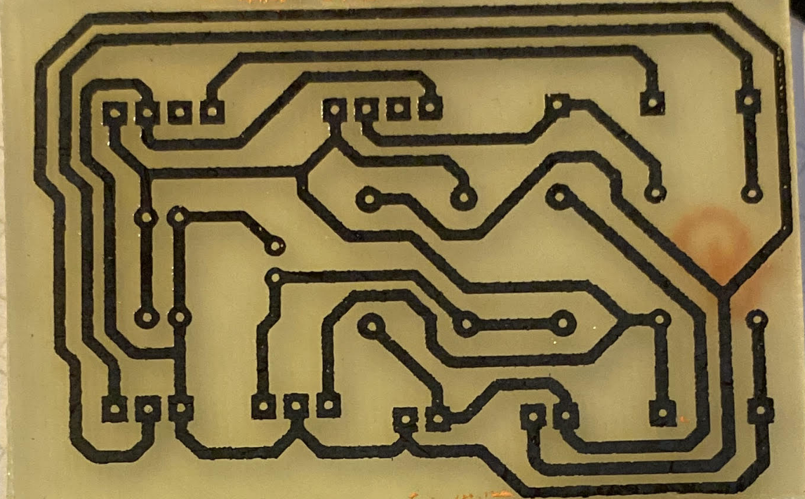
APPLYING THE DESIGNED PCB BOARD TO REALITY
After the transfer is completed, We throw our PCB card into acid solution. Our acid solution consists of hydrogen peroxide and muriatic acid.
HYDROGEN
PEROXIDE
MURIATIC
ACID
After throwing into acid solution
(MIX RATIO 1:3)

Slide 26
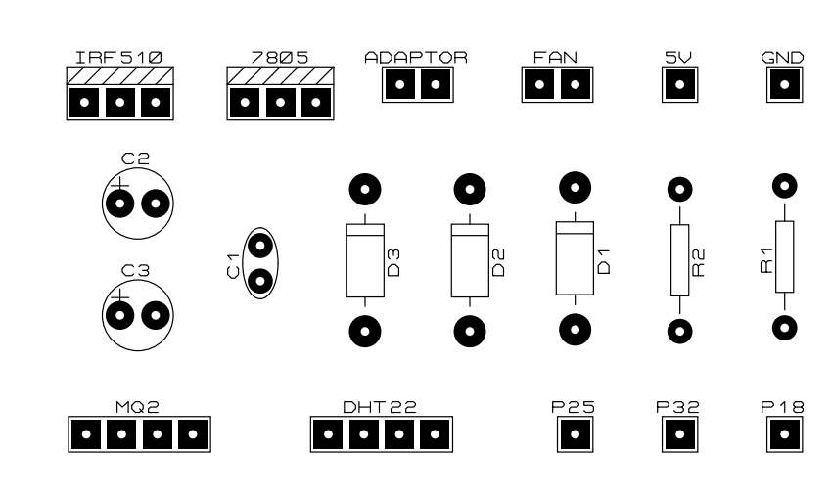
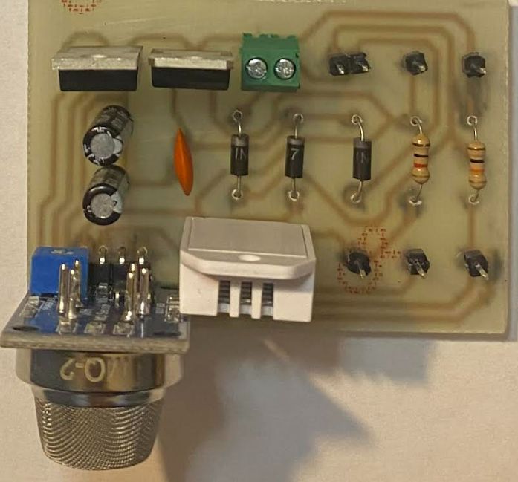
PLACING CIRCUIT ELEMENTS ON THE BOARD
We placed as shown in FIGURE 1 and soldered the circuit elements as shown in FIGURE 2.
(FIGURE 1)
AFTER SOLDERED (FIGURE 2)

Slide 27



SOFTWARE LANGUAGES AND SERVICES USED
Embedded System:
C++ (Arduino Library)
Web:
HTML
CSS
JavaScript
Services:
Firebase Realtime Database
Firebase Hosting
Firebase Authentication

Slide 28

OPERATING THE DEVICE

Slide 29
All Components

Slide 30

Thanks for Listening

